Slide 1


FAST
National University of Computer and Emerging Sciences Peshawar
OOP Lab # 1.3
C++ Type Conversion/Type Casting Instructor: Mazhar Iqbal
DEPARTMENT OF COMPUTER SCIENCE
الذی علم بالقلم۔ علم الانسان ما لم يعلم۔

Slide 2
Contents
C++ Type Conversion/Type Casting
Implicit Type Casting
Explicit Type Casting

Slide 3
C++ Type Conversion or Type Casting
C++ allows us to convert data of one type to that of another. This is known as type conversion.
There are two types of type conversion in C++.
Implicit Conversion
Explicit Conversion (also known as Type Casting)

Slide 4
1) Implicit Type Conversion
The type conversion that is done automatically done by the compiler is known as implicit type conversion.
This type of conversion is also known as automatic conversion.
Let us look at two examples of implicit type conversion.

Slide 5
Example 1: Conversion from int to double
#include <iostream>
using namespace std; int main() {
// assigning an int value to num_int
int num_int = 9; // declaring a double type variable
double num_double;
// implicit conversion
// assigning int value to a double variable
num_double = num_int; cout << "num_int = " << num_int << endl;
cout << "num_double = " << num_double << endl;
return 0;
}
Output:
num_int = 9
num_double = 9

Slide 6
Example 1: Conversion from int to double…
In the program, we have assigned an int data to a double variable.
Here, the int value is automatically converted to double by the compiler before it is assigned to the num_double variable.
This is an example of implicit type conversion.
num_double = num_int;

Slide 7
Example 2: Automatic Conversion from double to int
#include <iostream>
using namespace std;
int main() { int num_int;
double num_double = 9.99; // implicit conversion
// assigning a double value to an int variable
num_int = num_double; cout << "num_int = " << num_int << endl;
cout << "num_double = " << num_double << endl;
return 0;
}
Output:
num_int = 9
num_double = 9.99

Slide 8
Example 2: Automatic Conversion from double to int…
In the program, we have assigned a double data to an int variable.
num_int = num_double;
Here, the double value is automatically converted to int by the compiler before it is assigned to the num_int variable. This is also an example of implicit type conversion.
Note: Since int cannot have a decimal part, the digits after the decimal point are truncated in the above example.

Slide 9
Data Loss During Conversion (Narrowing Conversion)
As we have seen from the above example, conversion from one data type to another is prone (risk) to data loss.
This happens when data of a larger type is converted to data of a smaller type.

Slide 10
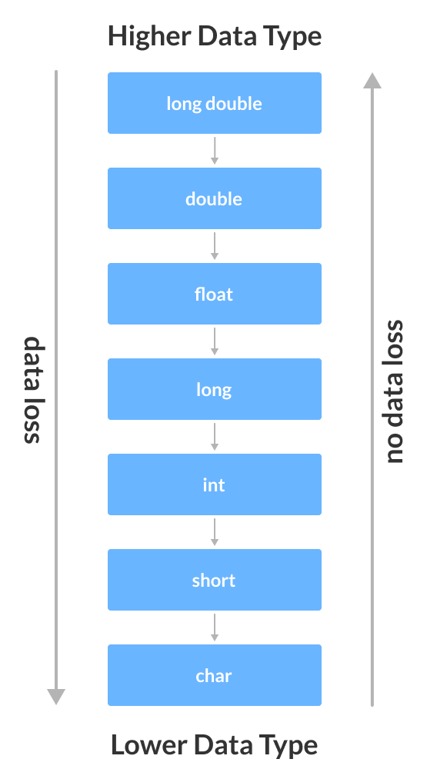
Data Loss During Conversion (Narrowing Conversion)…

Slide 11
2) C++ Explicit Conversion
When the user manually changes data from one type to another, this is known as explicit conversion. This type of conversion is also known as type casting.
There are three major ways in which we can use explicit conversion in C++. They are:
C-style type casting (also known as cast notation)
Function notation (also known as old C++ style type casting)
Type conversion operators

Slide 12
i) C-style Type Casting
As the name suggests, this type of casting is favored by the C programming language. It is also known as cast notation.
The syntax for this style is:
(data_type)expression;
// initializing int variable
int num_int = 26;
// declaring double variable
double num_double;
// converting from int to double
num_double = (double)num_int;

Slide 13
ii) Function-style Casting
We can also use the function like notation to cast data from one type to another.
The syntax for this style is:
data_type(expression);
int num_int = 26;
// declaring double variable
double num_double;
// converting from int to double
num_double = double(num_int);

Slide 14
Example 3: Type Casting
#include <iostream> using namespace std; int main() {
// initializing a double variable
double num_double = 3.56;
cout << "num_double = " << num_double << endl;
// C-style conversion from double to int
int num_int1 = (int)num_double;
cout << "num_int1 = " << num_int1 << endl;
// function-style conversion from double to int
int num_int2 = int(num_double);
cout << "num_int2 = " << num_int2 << endl;
return 0;
}
Output:
num_double = 3.56
num_int1 = 3
num_int2 = 3

Slide 15
Example 3: Type Casting…
We used both the C style type conversion and the function-style casting for type conversion and displayed the results.
Since they perform the same task, both give us the same output.

Slide 16
References
https://beginnersbook.com/2017/08/cpp-data-types/
https://www.geeksforgeeks.org/c-data-types/
http://www.cplusplus.com/doc/tutorial/basic_io/
https://www.geeksforgeeks.org/basic-input-output-c/
https://www.w3schools.com/cpp/default.asp
https://www.javatpoint.com/cpp-tutorial

Slide 17

THANK YOU
Thanks

